Slide 1
Cycle 1 Feedback
Your mark is posted to Canvas
Verbal recording
https://sydney.instructuremedia.com/embed/026c691d-b312-4fdc-b7bc-1ff3a0e889ff

Slide 2
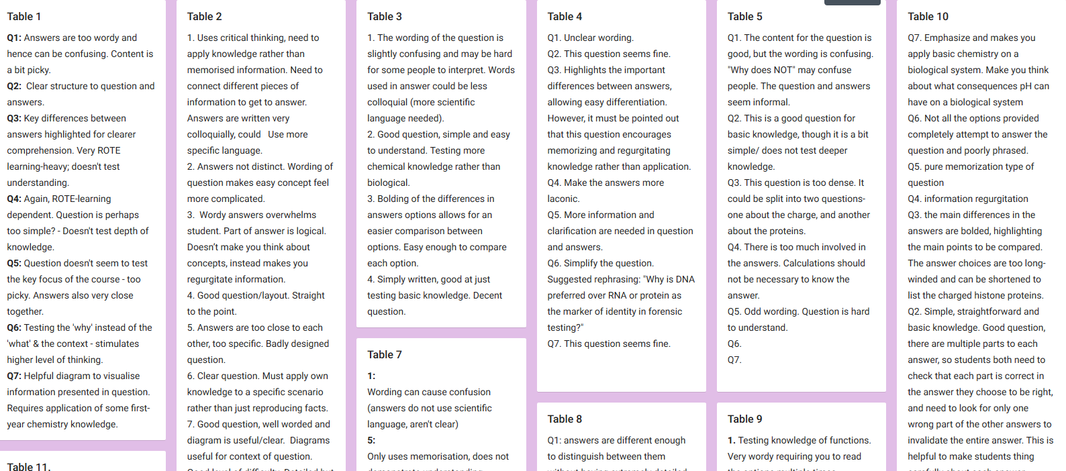
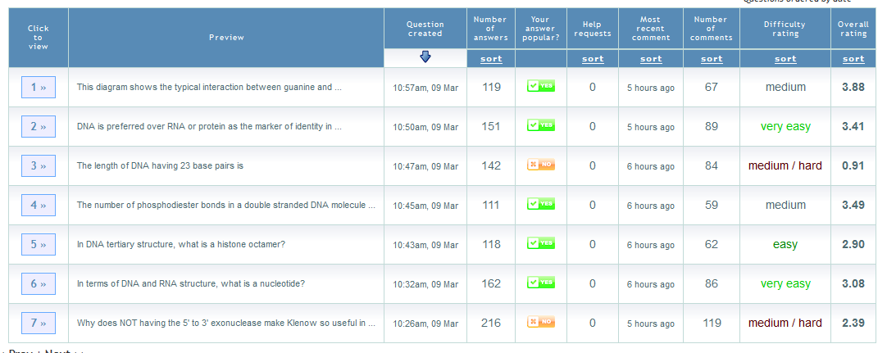
Your Reviews
Look at your Padlet opinions
Some excellent insight and articulation
And that was before you discovered Blooms!
The PeerWise site for criticism of the seven questions
Again, some top comments
Both Available for Download in Week 5

Slide 3
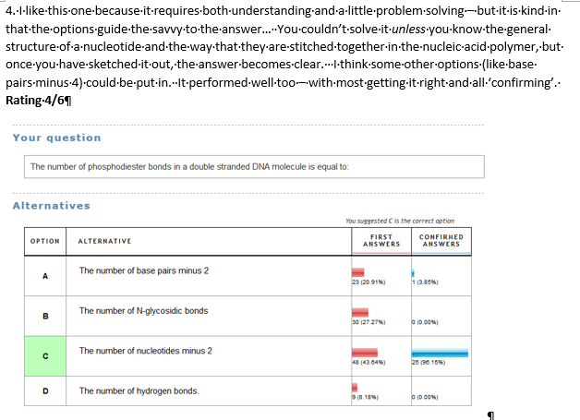
Our Reviews
See our opinions on Canvas
Note that I also based my feelings on choice distribution
Extra layer of intel
I’m also thinking of potential
The one rated best by quality and rough discrimination factor (DI) was by one of last year’s students ☺

Slide 4
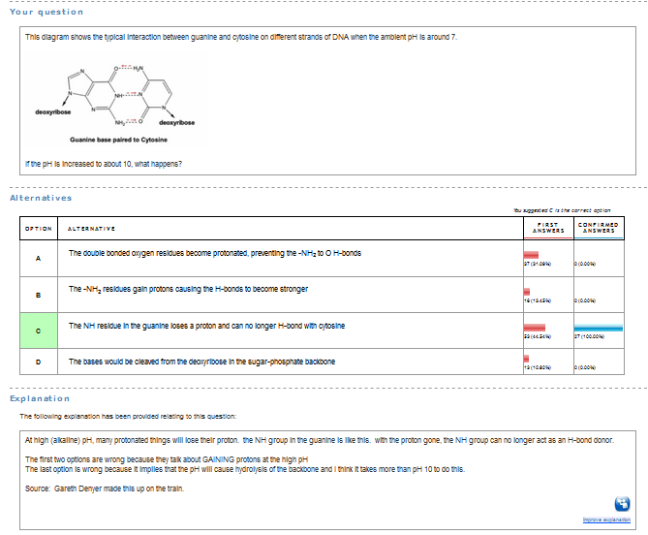
Question Submission (0.5 marks)
On time
Properly structured
Stem
Options
Explanation
Reference (source)
Table Tag (grace!)

Slide 5
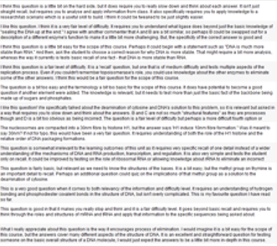
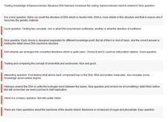
Comments (0.5 marks)
9 or more ON TIME comments
Quality
GOOD
Thoughtful, specific, constructive, insightful, suggestions, expansive, articulate, alignment to syllabus, reference to Blooms & granularity
POOR
Platitudes, perfunctory, general, repeat aspects of question
Judgement was holistic – the whole package
Also allows copy/paste to go unrewarded
GOOD
POOR, LATE

Slide 6
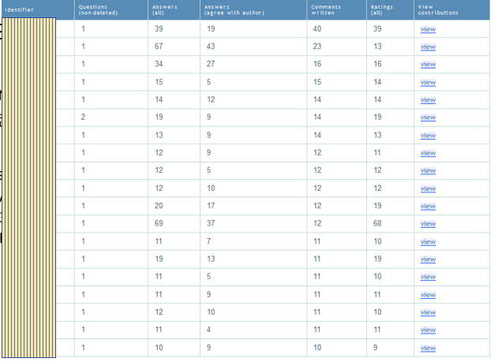
Overall
Authoring consistent
我觉得用英语比较好！
Commenting
Most people limited themselves to 10 questions ☹
About 30% uniformly good
30 % wholly poor
Rest were a mix
Choosing ‘easy’ questions ☹
More answering ☺ but…..

Slide 7
Poor Quality Comments
Stating the obvious, repeating the question
“This question tests knowledge on DNA replication”
“Need to know that phosphates makes DNA negatively charged”
Platitudes
“Good question”, “Solid question”, “Well Done!”
“I like the way you made the options”
General
“Needs rewriting”, “Not clear”, “Options confusing”
“Grammar poor”
“Content worth knowing”

Slide 8
Good Quality Comments
.. on that basis, I recommend that…
I think you are mistaken in saying…
Try rewording this to emphasize…
Watch out for the ambiguity between ….
Rephrase [like this] to take away the negative…
Shorten the option so that only one concept is in it – this can be done as []
This tricked me because I thought…
The background is not needed, just start by saying…
I think the concept [] is too granular, try this…
All are specific and actionable

Slide 9
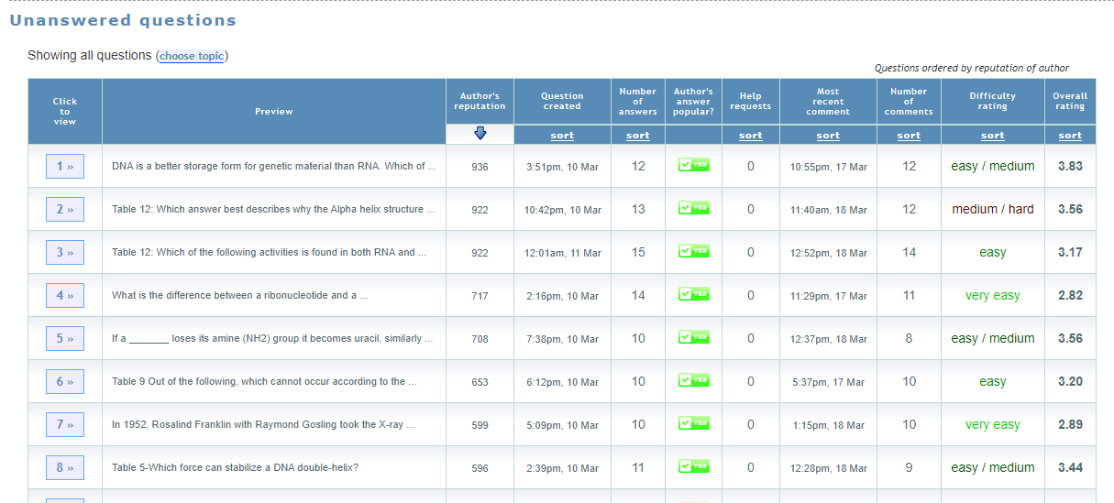
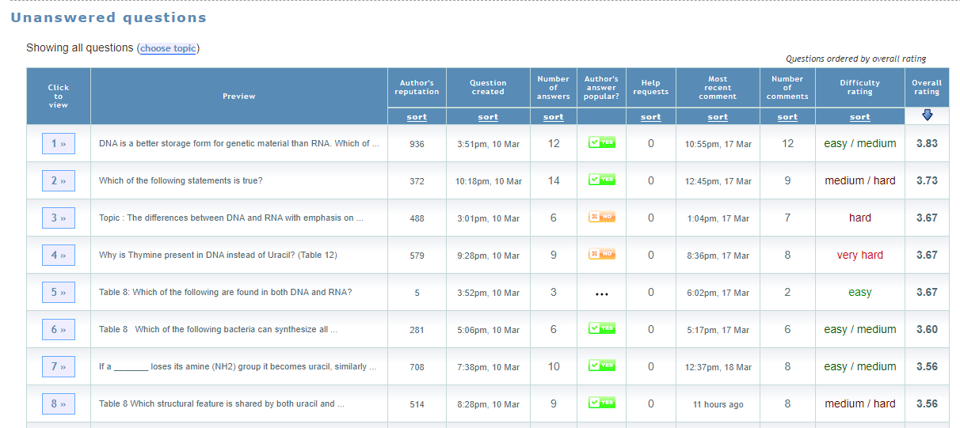
Picking the Best Questions
Sort by Reputation
For your revision….
Thought Leader Strategy
Find the students who gave the most thoughtful feedback
Find which questions they rated best
BUT not enough overlap
General ratings
Sort by rating
Sort by author reputation
Sort by Rating
We’ll take the top 10 from each and pool once Cycle 1 is over.
So do go in and rate, still.

